Slide 1
Text analytics
Overview
Practice areas

Slide 2
overview
Text mining and text analytics are broad umbrella terms describing a range of technologies for analyzing and processing semi structured and unstructured text data.
80% of an organization’s data is in text form and hence text mining is believed to have a commercial potential higher than that of data mining.
Emerging field, number of competing technologies with no clear dominance of a provider
A multidisciplinary field
More complex task (than data mining) as it involves dealing with text data that are unstructured and fuzzy
“turn text into numbers” so that the machine learning algorithms/statistics can be applied

Slide 3
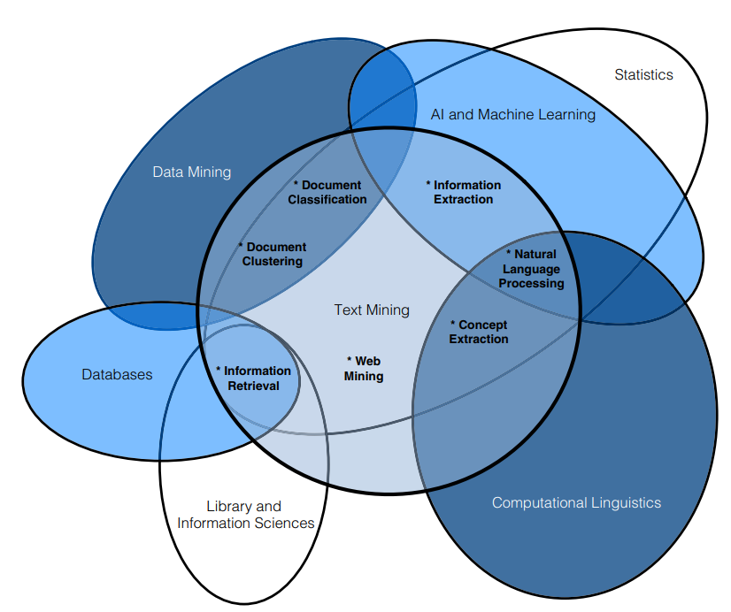
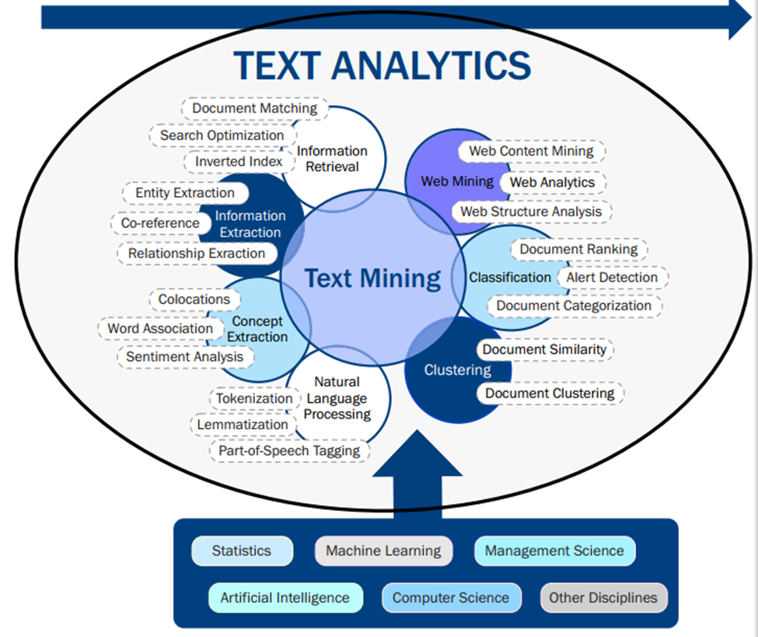
7 practice areas & 6 contributing fields of study

Slide 4
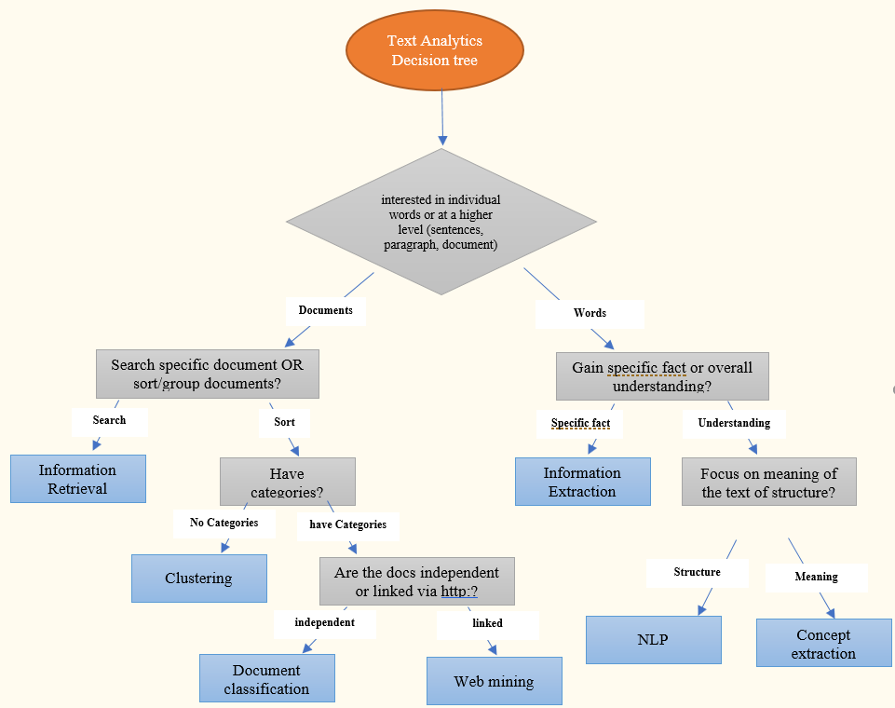
Which practice area to focus
IR (informational retrieval)
Document clustering
Document Classification
Web Mining
Information Extraction
NLP
Concept Extraction

Slide 5
NLP – natural language processing
NLP
Python tools for NLP (NLTK, Textblob, Gensim)
Text preprocessing
Tokenizing
Stemming
Lemmatization
PoS tagging
Stop words
Embeeding
Normalization
Text cleaning – punctuation, symbols, gaps etc
Text enrichment – emoticons, exclamations
TFIDF
Lexicons
BoW format for text analysis
Word2Vector format for text analysis
Creating pipelines for analysis
Text frequency analysis – unigrams, bigrams
Semantic analysis
Storing processed texts
Web scraping
Visualizing text analysis results

Slide 6
Nlp (natural language processing)
Natural Language Processing (NLP) is the task of making computers understand and produce human languages.
And it always starts with the corpus i.e. a body of text.

Slide 7
Varied Applications
Sentence segmentation, part-of-speech tagging, and parsing: Natural language processing can be used to analyze parts of a sentence to better understand the grammatical construction of the sentence.
Deep analytics: Deep analytics involves the application of advanced data processing techniques in order to extract specific information from large or multi-source data sets.
Machine translation: Natural language processing is increasingly being used for machine translation programs, in which one human language is automatically translated into another human language.
Named entity extraction: In data mining, a named entity definition is a phrase or word that clearly identifies one item from a set of other items that have similar attributes. Examples include first and last names, age, geographic locations, addresses, phone numbers, email addresses, company names, etc. Named entity extraction, sometimes also called named entity recognition, makes it easier to mine data.
Co-reference resolution: In a chunk of text, co-reference resolution can be used to determine which words are used to refer to the same objects.
Automatic summarization: Natural language processing can be used to produce a readable summary from a large chunk of text. For example, one might us automatic summarization to produce a short summary of a dense academic article.

Slide 8
Installing NLTK
Install NLTK with Python 2.x using:
pip install nltk
Install NLTK with Python 3.x using:
pip3 install nltk
Installation is not complete after these commands.
Open python and type:
import nltk
nltk.download()

Slide 9
Pre-processing
The sklearn.preprocessing package provides several common utility functions and transformer classes to change raw feature vectors into a representation that is more suitable for the downstream estimators.
In general, learning algorithms benefit from standardization of the data set.

Slide 10
Pre-processing - types
Standardization or mean removal and variance scaling
Scaling features to a range
Scaling sparse data
Scaling data with outliers
Binarization
Imputation of missing values
Non-linear transformation
Normalization
Encoding categorical features
Centering kernel matrices

Slide 11
Basics of nltk
What is a Corpus?
There are many corpora (plural of corpus) available in NLTK, lets start with an English one called the Brown corpus.
When using a new corpus in NLTK for the first time,
import nltk
nltk.download()

Slide 12
Tokenizing
Sentence tokenization is the process of splitting up strings into “sentences”
Word tokenization is the process of splitting up “sentences” into “words”

Slide 13
Lowercasing
The CAPS in the texts are RATHER unwanted at times, although we KNOW the intention is to EMPHASIZE on something. Useful in sentiment analysis.
We can simply lowercase them after we do sent_tokenize() and word_tokenize().

Slide 14
Stop words
stopwords are non-content words that primarily has only grammatical function
In NLTK, you can access them as follows:
from nltk.corpus import stopwords
Often we want to remove stopwords when we want to keep the "gist" of the document/ sentence.

Slide 15
punctuations
Sometimes, we want to remove the punctuations from the documents
If yes then
Combine the punctuation with the stopwords

Slide 16
Using a stronger/longer list of stopwords
https://github.com/6/stopwords-json
Czech | 346 | cs.json
Danish | 101 | da.json
Dutch | 275 | nl.json
English | 570 | en.json
Esperanto | 173 | eo.json
Estonian | 35 | et.json
Finnish | 772 | fi.json
French | 606 | fr.json
Galician | 160 | gl.json
German | 596 | de.json
Greek | 75 | el.json
Language | Stopword count | Filename
Afrikaans | 51 | af.json
Arabic | 162 | ar.json
Armenian | 45 | hy.json
Basque | 98 | eu.json
Bengali | 116 | bn.json
Breton | 126 | br.json
Bulgarian | 259 | bg.json
Catalan | 218 | ca.json
Chinese | 542 | zh.json
Croatian | 179 | hr.json

Slide 17
stronger/longer list of stopwords
Hausa | 39 | ha.json
Hebrew | 194 | he.json
Hindi | 225 | hi.json
Hungarian | 781 | hu.json
Indonesian | 355 | id.json
Irish | 109 | ga.json
Italian | 619 | it.json
Japanese | 109 | ja.json
Korean | 679 | ko.json
Latin | 49 | la.json
Latvian | 161 | lv.json
Marathi | 99 | mr.json
Norwegian | 172 | no.json
Persian | 332 | fa.json
Polish | 260 | pl.json
Portuguese | 408 | pt.json
Romanian | 282 | ro.json
Russian | 539 | ru.json
Slovak | 110 | sk.json
Slovenian | 446 | sl.json
Somalia | 30 | so.json
Southern Sotho | 31 | st.json

Slide 18
stronger/longer list of stopwords
Spanish | 577 | es.json
Swahili | 74 | sw.json
Swedish | 401 | sv.json
Thai | 115 | th.json
Turkish | 279 | tr.json
Yoruba | 60 | yo.json
Zulu | 29 | zu.json

Slide 19
Stemming & lemmatizing
Often we want to map the different forms of the same word to the same root word, e.g. "walks", "walking", "walked" should all be the same as "walk".
The stemming and lemmatization process to find the root word.
Stemming: Trying to shorten a word with simple regex rules
Lemmatization: Trying to find the root word with linguistics rules (with the use of regexes)
There are various stemmers and one lemmatizer in NLTK, the most common being:
Porter Stemmer from Porter (1980)
Wordnet Lemmatizer

Slide 20
examples
A stemmer for English operating on the stem cat should identify such strings as cats, catlike, and catty.
A stemming algorithm might also reduce the words fishing, fished, and fisher to the stem fish.
The stem need not be a word, however.
In the Porter algorithm, argue, argued, argues, arguing, and argus reduce to the stem argu.

Slide 21
Main differences between stemming and lemmatization
Stemming algorithms work by cutting off the end or the beginning of the word, taking into account a list of common prefixes and suffixes that can be found in an inflected word.
This indiscriminate cutting can be successful in some occasions, but not always
Form | Suffix | Stem
Studies | Es | studi
Studying | Ing | study
Number: fox, foxes
Tense: pay, paid, paying
Gender: waiter, waitress
Person: hear, hears
Case: I, me, my
Aspect: ate, eaten
Mood: so be it, were it so

Slide 22
Main differences between stemming and lemmatization
Lemmatization, on the other hand, takes into consideration the morphological analysis of the words.
To do so, it is necessary to have detailed dictionaries which the algorithm can look through to link the form back to its lemma.
a lemma is the base form of all its inflectional forms, whereas a stem isn’t.
Form | Suffix | Stem
Studies | Es | study
Studying | Ing | study

Slide 23
Lemmatizer needs context
The lemmatizer is actually pretty complicated, it needs Parts of Speech (POS) tags.
By default, the WordNetLemmatizer.lemmatize() function will assume that the word is a Noun if there's no explicit POS tag in the input.
First you need the pos_tag function to tag a sentence and using the tag convert it into WordNet tagsets and then put it through to the WordNetLemmatizer.
Note: Lemmatization won't really work on single words alone without context or knowledge of its POS tag (i.e. we need to know whether the word is a noun, verb, adjective, adverb)

Slide 24
PoS tagging
Tag | Description | Example
CC | conjunction, coordinating | and, or, but
CD | cardinal number | five, three, 13%
DT | determiner | the, a, these
EX | existential there | there were six boys
FW | foreign word | mais
IN | conjunction, subordinating or preposition | of, on, before, unless
JJ | adjective | nice, easy
JJR | adjective, comparative | nicer, easier
JJS | adjective, superlative | nicest, easiest
LS | list item marker

Slide 25
PoS tagging
LS | list item marker
MD | verb, modal auxillary | may, should
NN | noun, singular or mass | tiger, chair, laughter
NNS | noun, plural | tigers, chairs, insects
NNP | noun, proper singular | Germany, God, Alice
NNPS | noun, proper plural | we met two Christmases ago
PDT | predeterminer | both his children
POS | possessive ending | 's
PRP | pronoun, personal | me, you, it
PRP$ | pronoun, possessive | my, your, our
RB | adverb | extremely, loudly, hard

Slide 26
PoS tagging
RBR | adverb, comparative | better
RBS | adverb, superlative | best
RP | adverb, particle | about, off, up
SYM | symbol | %
TO | infinitival to | what to do?
UH | interjection | oh, oops, gosh
VB | verb, base form | think
VBZ | verb, 3rd person singular present | she thinks
VBP | verb, non-3rd person singular present | I think
VBD | verb, past tense | they thought

Slide 27
PoS tagging
VBN | verb, past participle | a sunken ship
VBG | verb, gerund or present participle | thinking is fun
WDT | wh-determiner | which, whatever, whichever
WP | wh-pronoun, personal | what, who, whom
WP$ | wh-pronoun, possessive | whose, whosever
WRB | wh-adverb | where, when
. | punctuation mark, sentence closer | .;?*
, | punctuation mark, comma | ,
: | punctuation mark, colon | :
( | contextual separator, left paren | (
) | contextual separator, right paren | )

Slide 28
PoS tagging - Chunk tags
Chunk tags are assigned to groups of words that belong together (i.e. phrases). The most common phrases are the noun phrase (NP, for example the black cat) and the verb phrase (VP, for example is purring).
Tag | Description | Words | Example | %
NP | noun phrase | DT+RB+JJ+NN + PR | the strange bird | 51
PP | prepositional phrase | TO+IN | in between | 19
VP | verb phrase | RB+MD+VB | was looking | 9
ADVP | adverb phrase | RB | also | 6
ADJP | adjective phrase | CC+RB+JJ | warm and cosy | 3
SBAR | subordinating conjunction | IN | whether or not | 3
PRT | particle | RP | up the stairs | 1
INTJ | interjection | UH | hello | 0

Slide 29
From Strings to Vectors
Vector is an array of numbers
Vector Space Model is conceptualizing language as a whole lot of numbers
Bag-of-Words (BoW): Counting each document/sentence as a vector of numbers, with each number representing the count of a word in the corpus
To count, we can use the Python collections.Counter

Slide 30
Vectorization
words and counts into a table:
sent1 = "The quick brown fox jumps over the lazy brown dog."
sent2 = "Mr brown jumps over the lazy fox."
 | brown | quick | fox | jump | lazy | dog | mr
Sent1 | 2 | 1 | 1 | 1 | 1 | 1 | 0
Sent2 | 1 | 0 | 1 | 1 | 1 | 0 | 1

Slide 31
Vectorization with sklearn
In scikit-learn, there're pre-built functions to do the preprocessing and vectorization that we've been doing using the CountVectorizer object. ☺
It will be the object that contains the vocabulary (i.e. the first row of our table above) and has the function to convert any sentence into the counts vectors we see as above. ☺
The input that CountVectorizer is a text file, so we've to do some hacking to let it accept the string outputs.
Use io.StringIO where we can convert any string to work like a file

Slide 32
CountVectorizer in sklearn
CountVectorizer(
input=’content’, encoding=’utf-8’,
decode_error=’strict’, strip_accents=None,
lowercase=True, preprocessor=None,
tokenizer=None, stop_words=None,
token_pattern=’(?u)\b\w\w+\b’, ngram_range=(1, 1),
analyzer=’word’, max_df=1.0, min_df=1,
max_features=None, vocabulary=None,
binary=False, dtype=<class ‘numpy.int64’>)[source]
preprocessor : callable or None (default)
Override the preprocessing (string transformation) stage while preserving the tokenizing and n-grams generation steps.
tokenizer
callable or None (default) - Override the string tokenization step while preserving the preprocessing and n-grams generation steps. Only applies if analyzer == 'word'..
Lowercase : boolean, True by default
analyzer : string, {‘word’, ‘char’, ‘char_wb’} or callable
Whether the feature should be made of word or character n-grams.
stop_words : string {‘english’}, list, or None (default)
If ‘english’, a built-in stop word list for English is used. If a list, that list is assumed to contain stop words, all of which will be removed from the resulting tokens. Only applies if analyzer == 'word'. If None, no stop words will be used.

Slide 33
Standardization (or Z-score normalization)
The result of standardization (or Z-score normalization) is that the features will be rescaled so that they’ll have the properties of a standard normal distribution with
μ=0 and σ=1 i.e. zero mean and unit variance
where μ is the mean (average) and σ is the standard deviation from the mean; standard scores (also called z scores) of the samples are calculated as follows:-
z=(x−μ)/σ
Standardizing the features so that they are centered around 0 with a standard deviation of 1
- it is not only important if we are comparing measurements that have different units
also a general requirement for many machine learning algorithms
Sklearn provides scale to standardize the data.

Slide 34
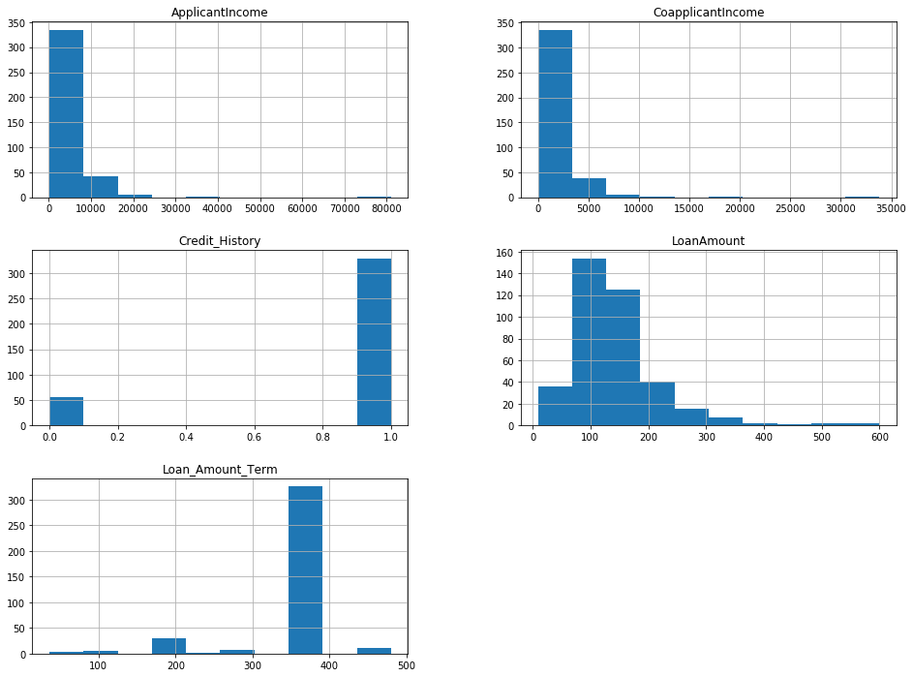
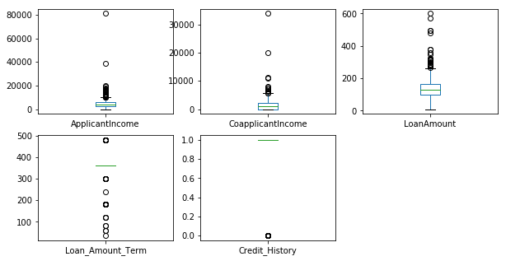
Example
Refer E:\python\pproc-feature-scaling.py

Slide 35
Example
ApplicantIncome and CoapplicantIncome are in similar range (0-50000$)
LoanAmount is in thousands and it ranges from 0 to 600$.
Loan_Amount_Term is in months
Other variable unit is dollars.
If we try to apply distance based methods such as kNN on these features, feature with the largest range will dominate the outcome results and we’ll obtain less accurate predictions.
We can overcome this trouble using feature scaling

Slide 36
Some examples of algorithms where feature scaling matters
k-nearest neighbors with an Euclidean distance measure if want all features to contribute equally
k-means (see k-nearest neighbors)
logistic regression, SVMs, perceptrons, neural networks etc. if you are using gradient descent/ascent-based optimization, otherwise some weights will update much faster than others
linear discriminant analysis, principal component analysis, kernel principal component analysis since you want to find directions of maximizing the variance (under the constraints that those directions/eigenvectors/principal components are orthogonal); you want to have features on the same scale since you’d emphasize variables on “larger measurement scales” more.

Slide 37
Text classification
Overview
Methods
Python implementation

Slide 38
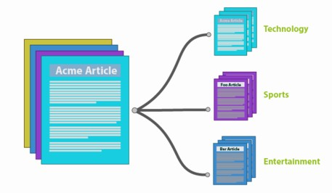
overview
Document classification is an example of Machine Learning (ML) in the space of Natural Language Processing (NLP).
By classifying text, we are aiming to assign one or more classes or categories to a document, making it easier to manage and sort.

Slide 39
Classification Process – a simple view
Step 1: Sample documents (training
Step 2: Take all of the words in the 3 documents in training set and creating a table or vector from these words.
Step 3: When a new untagged document comes for classification and it contains the words “Orange is a color” we would create a word vector for it by marking the words which exist in our classification vector.
Ref | Text | Class
Doc 1 | Some tigers live in the zoo | 1
Doc 2 | Green is a color | 2
Doc 3 | Go to New Your City | 3
 | some | tigers | live | in | the | zoo | green | is | a | color | go | to | new | york | city | Class
Doc 1 | 1 | 1 | 1 | 1 | 1 | 1 | 0 | 0 | 0 | 0 | 0 | 0 | 0 | 0 | 0 | 1
Doc 2 | 0 | 0 | 0 | 0 | 0 | 0 | 1 | 1 | 1 | 1 | 0 | 0 | 0 | 0 | 0 | 2
Doc 3 | 0 | 0 | 0 | 0 | 0 | 0 | 0 | 0 | 0 | 0 | 1 | 1 | 1 | 1 | 1 | 3
 | some | tigers | live | in | the | zoo | green | is | a | color | go | to | new | york | city | Class
Doc 1 | 0 | 0 | 0 | 0 | 0 | 0 | 0 | 1 | 1 | 1 | 0 | 0 | 0 | 0 | 0 | 2

Slide 40
Ways to text classification
Decision Trees
Support Vector Machines
K Nearest Neighbors
Naive-Bayes
Supervised Latent Dirichlet Allocation (SLDA)
Random Forests
Support Vector Machines (SVM)
Boosting and Bagging algorithms
Neural Networks
Logistic Regression

Slide 41
Some well-known text classification benchmarks
AG’s news articles
Sogou news corpora
Amazon Review Full
Amazon Review Polarity
DBPedia
Yahoo Answers
Yelp Review Full
Yelp Review Polarity

Slide 42
Paper implementation
Diabetes data, twitter, python, mongoDB

Slide 43
Extract data from MongoDB
Keep the original tweet
Do not consider the RTs
Do consider Favorites
Take the text from quote_tweets
Keep the replies
Document category | #count
Count of total number of tweets
Count of RTs (no quote)
Count of favorites
Count of RTS (Quotes)
Count of replies

Slide 44
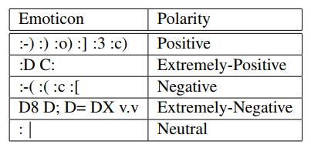
Twitter data - preprocessing
STEP 0
2 resources for pre-processing twitter data
Prepare the emoticon dictionary by labeling 170 emoticons listed on Wikipedia with their emotional state.
For example, “:)” is labeled as positive whereas “:=(” is labeled as negative.
Assign each emoticon a label from the following set of labels:
Extremely-positive,
Positive,
Negative
Extremely-negative,
and Neutral.
an emoticon dictionary
2) an acronym dictionary
compile an acronym dictionary from an online resource. The dictionary has translations for 5,184 acronyms.
For example, lol is translated to
laughing out loud.
http://www.noslang.com/
Acronym | English expansion
gr8, gr8t | great
lol | laughing out loud
rotf | rolling on the floor
http://en.wikipedia.org/wiki/List of emoticons
http://www.webconfs.com/stop-words.php

Slide 45
Twitter data - preprocessing
STEP 1
Replace all the emoticons with a their sentiment polarity
by looking up the emoticon dictionary

Slide 46
Twitter data - preprocessing
STEP 2
Replace all URLs with a tag _U
text = 'Hello …. I am fine … http://techXlearning.com ...’
text = re.sub(r’http\S+’, ‘_U’, text)
text = re.sub(r’\w+:\/\/\S+’, ‘_U’, text)

Slide 47
Twitter data - preprocessing
STEP 3
Replace targets (e.g. “@John”) with tag ||T||

Slide 48
Twitter data - preprocessing
STEP 4
Replace all negations (e.g. not, no, never, n’t, cannot) by tag “NOT”

Slide 49
Twitter data - preprocessing
STEP 5
Replace a sequence of repeated characters by three characters, for example, convert coooooooool to coool.
We do not replace the sequence by only two characters since we want to differentiate between the regular usage and emphasized usage of the word.

Slide 50
Twitter data - preprocessing
STEP 1
Removing unimportant or disturbing elements
There are fourteen punctuation marks commonly used in English grammar. They are the
period,
question mark,
exclamation point,
comma,
semicolon,
colon,
dash,
hyphen,
parentheses,
brackets,
braces,
apostrophe,
quotation marks,
and ellipsis
A clean tweet should not contain
URLs, hashtags (i.e. #happy) or mentions (i.e. @BarackObama).
Tabs and line breaks (should be replaced with a blank and quotation marks with apexes)

Slide 51
Twitter data - preprocessing
STEP 2
Removing all the punctuation, except for apexes
There are fourteen punctuation marks commonly used in English grammar. They are the period, question mark, exclamation point, comma, semicolon, colon, dash, hyphen, parentheses, brackets, braces, apostrophe, quotation marks and ellipsis

Slide 52
Twitter data - preprocessing
STEP 3
convert many types of emoticons into tags that express
their sentiment (i.e. :) → smile happy)
There are fourteen punctuation marks commonly used in English grammar. They are the period, question mark, exclamation point, comma, semicolon, colon, dash, hyphen, parentheses, brackets, braces, apostrophe, quotation marks and ellipsis

Slide 53
Twitter data - preprocessing
STEP 4
all the text is converted to lower case and extra blank spaces are
removed
There are fourteen punctuation marks commonly used in English grammar. They are the period, question mark, exclamation point, comma, semicolon, colon, dash, hyphen, parentheses, brackets, braces, apostrophe, quotation marks and ellipsis

Slide 54
Algorithms - implementation

Slide 55
Naïve Bayes
https://monkeylearn.com/blog/practical-explanation-naive-bayes-classifier/
https://github.com/taspinar/siml/blob/master/notebooks/Naive_Bayes.ipynb (income slab prediction)
https://appliedmachinelearning.wordpress.com/2017/05/23/understanding-naive-bayes-classifier-from-scratch-python-code/ (flu prediction)
https://www.3pillarglobal.com/insights/document-classification-using-multinomial-naive-bayes-classifier DOCUMENT CLASSIFICATION
http://dataaspirant.com/2017/02/06/naive-bayes-classifier-machine-learning/
https://www.geeksforgeeks.org/naive-bayes-classifiers/ (PLAY GOLF OR NOT)
http://textblob.readthedocs.io/en/dev/classifiers.html text classification
http://www.dataschool.io/simple-guide-to-confusion-matrix-terminology/ (confusion matrix)

Slide 56
Python libraries
NLTK
TextBlob
Stanford CoreNLP
SpaCy
Gensim

Slide 57
NLTK
NLTK is also popular for education and research.
NLTK has over 50 corpora and lexicons, 9 stemmers, and dozens of algorithms to choose from.
Heavy and slippery,
it has a steep learning curve.
it’s slow and not production-ready
Resources
NLTK Book – Complete course on Natural Language Processing in Python with NLTK.
http://www.nltk.org/book/
Dive into NLTK – Detailed 8-part tutorial on using NLTK for text processing.
http://textminingonline.com/dive-into-nltk-part-i-getting-started-with-nltk

Slide 58
TextBlob
TextBlob sits on the mighty shoulders of NLTK and another package called Pattern
TextBlob is a simple, fun library that makes text analysis a joy.
Resources
TextBlob Documentation – Official documentation and quickstart guide.
Natural Language Processing Basics with TextBlob – Excellent, short NLP crash course using TextBlob.

Slide 59
Stanford CoreNLP
Stanford CoreNLP is a suite of production-ready natural analysis tools. It includes part-of-speech (POS) tagging, entity recognition, pattern learning, parsing, and much more.
is actually written in Java, not Python. You can get around this with Python wrappers made by the community.
Many organizations use CoreNLP for production implementations.
It’s fast, accurate, and able to support several major languages.
Resources
CoreNLP Documentation – Official documentation and resource compilation.
List of Python wrappers for CoreNLP – Kept up-to-date by Stanford NLP.

Slide 60
spacy
SpaCy is the new kid on the block, and it’s making quite a splash. It’s marketed as an “industrial-strength” Python NLP library that’s geared toward performance.
SpaCy is minimal and opinionated, and it doesn’t flood you with options like NLTK does. Its philosophy is to only present one algorithm (the best one) for each purpose. You don’t have to make choices, and you can focus on being productive.
Because it’s built on Cython, it’s also lightning-fast. Folks have called spaCy “state-of-the-art
Its main weakness is that it currently only supports English.
SpaCy is newer, so its support community is not as large as some other libraries’. Yet, its approach to NLP is so compelling that it could possible dethrone NLTK.
If you’re building a new application or revamping an old one (and you only need English support), then we strongly recommend trying spaCy.
Resources
spaCy Documentation – Official documentation and quickstart guide.
Intro to NLP with SpaCy – Short tutorial showcasing spaCy’s functionality.

Slide 61
gensim
Gensim is a well-optimized library for topic modeling and document similarity analysis. Among the Python NLP libraries listed here, it’s the most specialized.
Even so, it’s a valuable tool to add to your repertoire. Its topic modeling algorithms, such as its Latent Dirichlet Allocation (LDA) implementation, are best-in-class. In addition, it’s robust, efficient, and scalable.
Plus, the sub-field semantics analysis (or topic modeling), is one of the most exciting areas of modern natural language processing.
Resources
gensim Documentation – Official documentation and tutorials. The tutorials page is very helpful.

Slide 62
visualization

Slide 63
Parallel coordinates plot
plotting multivariate, numerical data.
ideal for comparing many variables together and seeing the relationships between them.
compare an array of products with the same attributes
E.g. comparing computer or cars specs across different models

Slide 64
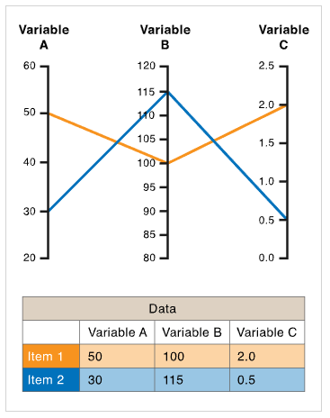
Description
Each variable is given its own axis and all the axes are placed in parallel to each other.
Each axis can have a different scale, as each variable works off a different unit of measurement, or all the axes can be normalized to keep all the scales uniform.
Values are plotted as a series of lines that connected across all the axes.
Key points
Order of axes
Relationship between adjacent variables is easy to perceive
can become over-cluttered, dense and difficult to comprehend

